Slide 1

microServiceBus.com
tutorial
Mikael Hakansson
mikael.hakansson@axians.com

Slide 2
IoT Device Management - using microServiceBus.com
Introduction
AXIANS IoT – View on Internet of Things
Labs

Slide 3





http://bit.ly/msbtutorial
Tools & Services
Chrome
Node.js
Visual Studio Code
Postman
GitHub
microServiceBus

Slide 4
Axians IoT Nordic’s
take on IoT

Slide 5






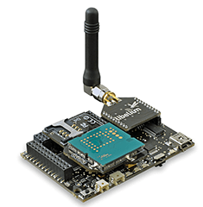













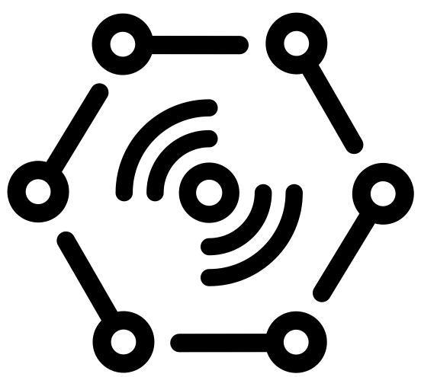





Challenges
Onboarding
Hub independence
Updates & Patches
Issue tracking
Monitoring
Reports
“Any DEvice”
Value
Apps
DATA
“Any Data Source”
“Any IoT platform”
Monitoring
“Any PROTOCOL”
Machine
Learning
PROTOCOL
DATA
LOB
Modbus
Wi-Fi
LoRa
Serial

Slide 6





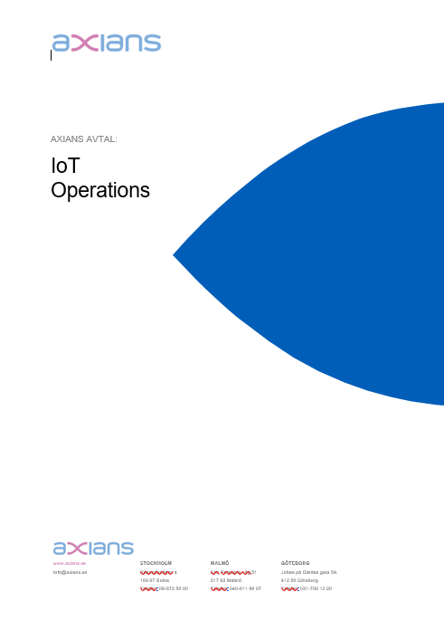
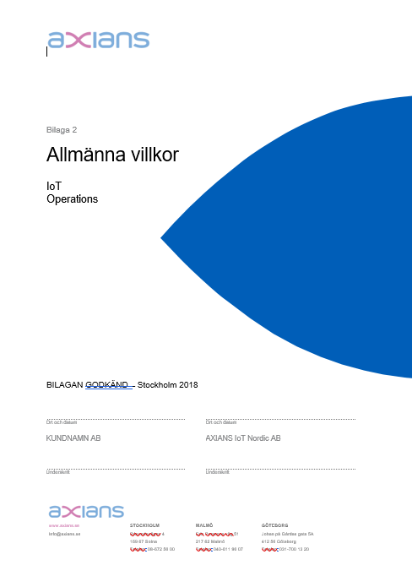
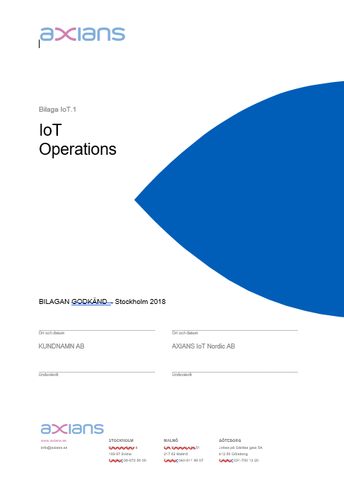
IoT Operations generic offering
IoT Nordic
PLC’s
Machines, Sensors,
meters etc...
Gateway (Devices)
Communi-cation
Cloud
IoT Operations
Business Solution
Set price per device & month.

Slide 7
Customer Response

Slide 8

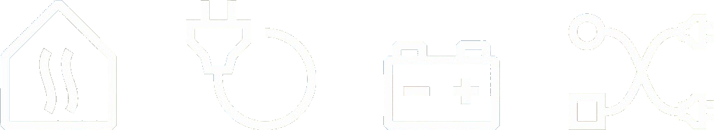

DES Business Platform
HEAT
POWER
CHARGE
SMART

Slide 9













HEAT
POWER
CHARGE
SMART
Power meter
IoT Hub
Event processing
Analysis & Readings
Power meter
Heat pump
//
Energy meter
Model
Web App
Energy meter
Field Gateway
vattenfall.microServiceBus.com
Device Management

Slide 10

HEAT
POWER
CHARGE
SMART
Power meter
IoT Hub
Event processing
Analysis & Readings
Power meter
Heat pump
//
Energy meter
Model
Web App
Energy meter
Solar home
Field Gateway
vattenfall.microServiceBus.com
Device Management

Slide 11
HEAT
POWER
CHARGE
SMART

Slide 12














HEAT
POWER
CHARGE
SMART
AI
vattenfall.microServiceBus.com
Device Management
Site
Power meter
IoT Hub
Field Gateway
Solar
Forecasting
Charging controller
Battery controller
Wind
Charging
Battery
Spot Price
Weather
Grid

Slide 13







HEAT
POWER
CHARGE
SMART
Whitelist Mgmt
Site
vattenfall.microServiceBus.com
Device Management
Energy meters
Energy meters
Energy meters
IoT Hub
Energy meters
Storage
Admin
Energy meters
Energy meters
Energy meters
Water meters
Energy meters
Field Gateway
Energy meters
Energy meters
Hum. meters
Billing
Pre-process
Azure
Blob storage

Slide 14
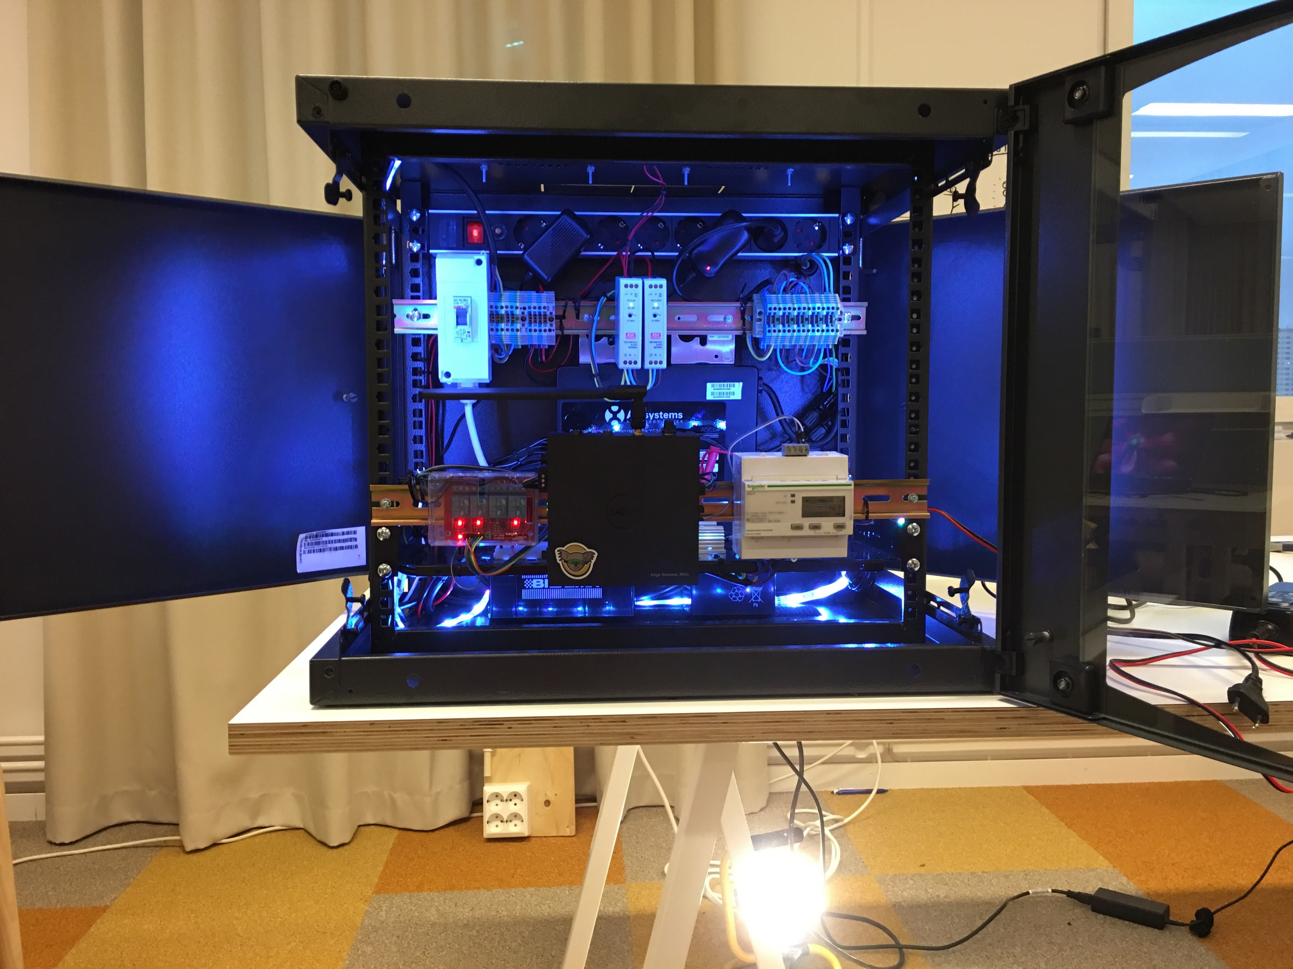
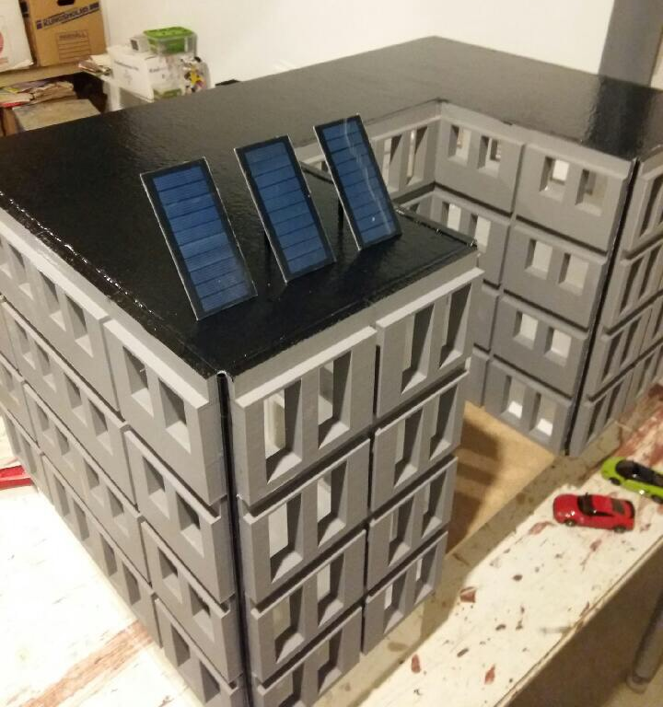

HEAT
POWER
CHARGE
SMART

Slide 15

SANDVIK INTELLIGENT TUBE
Sandviken - Intelligent Tubes
SMART INDUSTRY

Slide 16



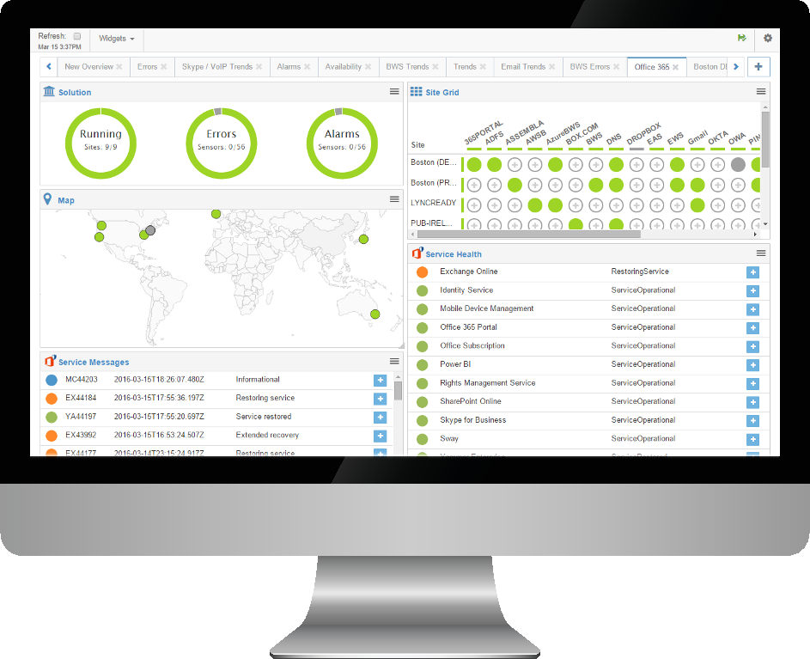
30% higher energy consumption…Why?

Slide 17
-But wait…there is more

Slide 18

The Edge , - Amsterdam

Slide 19

Berlin - Subway

Slide 20

Rotterdam - Harbor

Slide 21
So how does microServiceBus.com fit in?

Slide 22
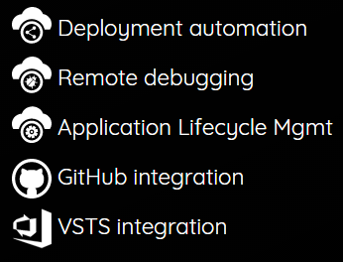


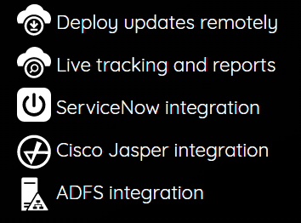


Axians – IoT Operation
Device Mgmt
Customer A
IOT HUB
Customer B
IOT HUB
Customer C
IOT HUB

Slide 23



Axians – IoT Operation
Device Mgmt
Customer A
IOT HUB
SERVICE DESK
Customer B
IOT HUB
NETWORK OPERATIONS CENTER
Customer C
IOT HUB

Slide 24
Axians – IoT Operation
Device Mgmt
Customer A
IOT HUB
Incidents
Issue tracking
Problem Management
Change Management
Release Management
Knowledge base
ITIL
SERVICE DESK
Customer B
IOT HUB
NETWORK OPERATIONS CENTER
Customer C
IOT HUB

Slide 25
IoT platforms
Certificates
SAS
Revoke
Sensor
Data
GATEWAY/ DEVICE
Transport
SECURITY
RULES & ROUTING
REPORTS
SQL / NOSQL
DEVICE MGMT
ERP / LOB
API
API
Node.js
ARM mbed
Java
.Net
Python
MQTT
AMQP
WebSockets
HTTP
Add/Remove
Enable/Disable
Metadata
State

Slide 26
General Device Architecture
Field Gateway
Sensor API
COM SDK
Security
Plan for change
On-boarding strategy
Agent
<CODE>
Platform
mBed | Node.js | Python | Java | .Net
Operating system
Linux | Windows | RTOS

Slide 27
microServiceBus Architecture (node.js)
Field Gateway
Interacting with sensors & business logic
Frequently updates
Service
Service
Service
Responsible for IoT Hub & orchestration of services
Often updates
Agent
microServiceBus-core
Responsible for communication with mSB.com
Rarely updates
Agent
microServiceBus-node
Platform
Node.js
Operating system
Linux | Windows

Slide 28
microServiceBus Architecture (node.js)
Field Gateway
Interacting with sensors & business logic
Frequently updates (weekly)
Service
Service
Service
Responsible for IoT Hub & orchestration of services
Often updates (once or twice a month)
Agent
microServiceBus-core
Responsible for communication with mSB.com
Rarely updates (once or twice a year)
Agent
microServiceBus-node
Platform
Node.js
Operating system
Linux

Slide 29


Ubuntu Core/Docker Device Architecture
Field Gateway
Interacting with sensors & business logic
Frequently updates (weekly)
Service
Service
Service
Responsible for IoT Hub & orchestration of services
Often updates (once or twice a month)
Agent
microServiceBus-core
Responsible for communication with mSB.com
Rarely updates (once or twice a year)
Agent
microServiceBus-node
Platform
Node.js
Operating system
Linux | Windows

Slide 30

Yocto Device Architecture
Görlitz enQube
Service
Service
Service
Service
Service
Service
Agent
Agent
microServiceBus-core
microServiceBus-core
Agent
Agent
microServiceBus-node
microServiceBus-node
Platform
Platform
Node.js
Node.js
Yocto Image
Operating system
Operating system
Linux (Yocto)
Linux (Yocto)

Slide 31
GitHub Repos:
axians/microservicebus.com (private)
axians/microservicebus.functions (private)
axians/microservicebus.node (public)
axians/microservicebus.core (public)
axians/microservicebus.mbed (public)
axians/microservicebus.gccbuild (public)
axians/microservicebus.snippets (public)
axians/microservicebus.rootservices (public)
axians/microservicebus.tutorial (public)
axians/microservicebus.docs (public)
You are more than welcome to help out!

Slide 32





microServiceBus.com and related projects are property of Vinci-Energies!

Slide 33
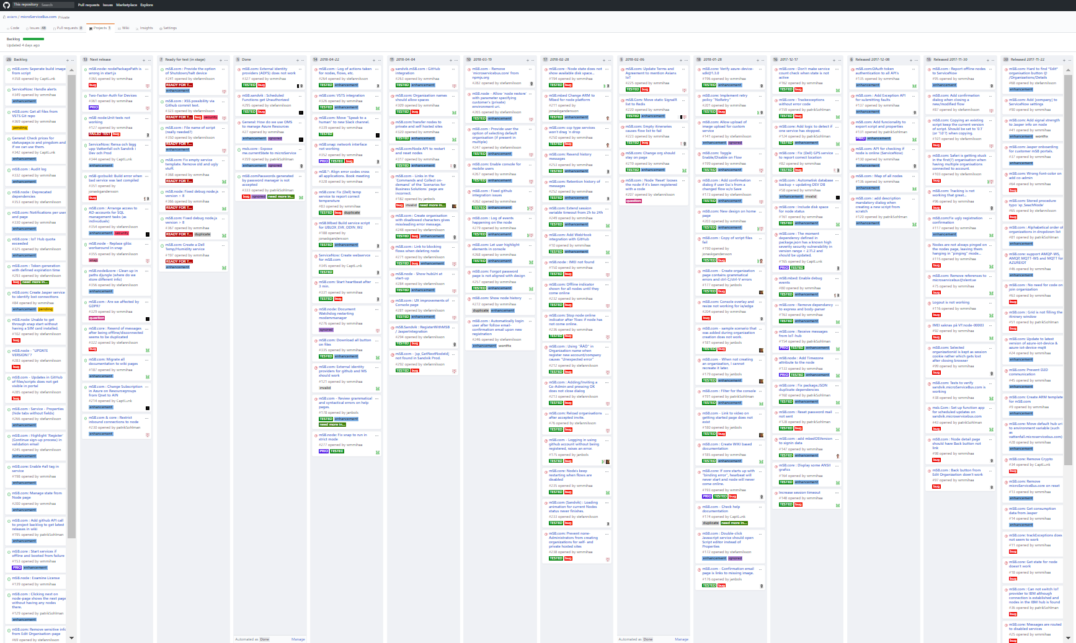
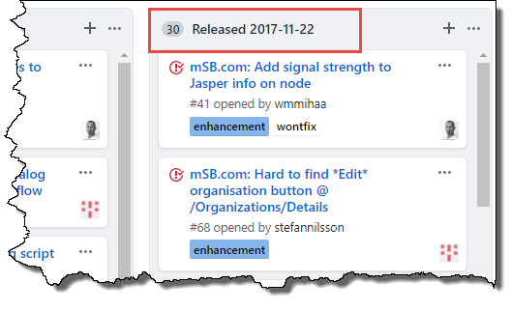
1000+ commits in 6 months!

Slide 34

microServiceBus.com DOCS https://docs.microservicebus.com/

Slide 35
Let’s begin https://github.com/axians/microservicebus-tutorial

Slide 36
(very) Short introduction to Node.js

Slide 37

What is Node.js?
Node.js® is a JavaScript runtime built on Chrome's V8 JavaScript engine.
Node.js uses an single threaded, event-driven, non-blocking I/O model that makes it lightweight and efficient.
Node.js is platform independent.

Slide 38
What is Node.js?
APPLICATION
NODE.JS
BINDINGS
(NODE API)
LIBUV
(ASYNCHRONOUS I/O)
JAVASCRIPT
EVENT QUEUE
WORKER THREADS
BLOCKING OPERATION
V8
(JAVASCRIPT ENGINE)
FILE
NETWORK
OS OPERATIONS
EVENT LOOP
PROCESS
EXECUTE CALLBACK

Slide 39

What is JavaScript?
A high-level, dynamic, untyped, and interpreted programming language. It has been standardized in the ECMAScript language specification
Notes:
High-level … förlåtande
Förklara att javascript är ett JIT kompilerat språk
var a = 2;
console.log(a);
3();

Slide 40

Node Package Manager (NPM)
npm is the default package manager for the JavaScript runtime environment Node.js and allows users to consume and distribute JavaScript modules that are available on the registry.
Npm has over 500K+ packages today, which is almost as much as Java, .Net and Python combined!

Slide 41
Demo!
+
Notes:
Understryk att detta inte är en JS kurs. All kod kan kopieras
console.log via terminal
console.log via app.js
npm i colosrs
console.log via app.js w/ colors

Slide 42
microServiceBus.com - Key concepts
Organization
“Subscription” owning flows, services & nodes
Services
Nodes
Cloud connected agent, hosting one or more flows
Code interacting with HW or other services
Inbound service
Outbound service
Other service
Flows
Process execution of services

Slide 43
Demo!

Slide 44








microServiceBus Architecture
IoT Hub
microServiceBus.com
Issue tracking
Field Gateway

Slide 45
ServiceNow integration
microServiceBus.com
Issue tracking
{Create CI}
{offline node}
{Create Create Incident}
{tracking}
Field Gateway

Slide 46

microServiceBus Architecture
IoT Hub
microServiceBus.com
Sim card mgmt
Field Gateway

Slide 47



On-boarding
4. Register device
3. Notification
IOT HUB
SIM CARD MANAGEMENT
IoT Hub
microServiceBus.com
DEVICE MANAGEMENT
5. Credentials
6. Config
2. Request config
?
7. Send & Receive
1. Activate SIM card
IOT DEVICE

Slide 48



Getting Started
Sensor
Gateway
Azure
IoT Hub
Azure
Stream Analytics
Microsoft
Power BI
microServiceBus.com

Slide 49
Lab time!
http://bit.ly/msbtutorial
Tools & Services
Chrome
Node.js
Visual Studio Code
Postman
GitHub
microServiceBus

Slide 50
Lab time!
http://bit.ly/msbtutorial
Getting started: Build your first solution
Device Management: Manage your devices and IoT Hub
Working with Policies: Manage how your Nodes handle disconnected state
Working with Templates: Simplify configuration of nodes
Insight and audit logs: Manage your devices and IoT Hub
Application Lifecycle Management: Manage your devices and IoT Hub
microServiceBus.com API: Integrate with microServiceBus.com API

